Slide 1
Investments
Background and Issues
Joseph Farizo
To Accompany Ch. 1 of BKM 11ed

Slide 2
Contents

Slide 3
1. What is an Investment?

Slide 4
What is an Investment?
A reduction of current consumption for greater future consumption.
Purchase stock, collect dividends, sell stock later
Buy a bond, collect coupon payments, collect principal at maturity
Pay college tuition, learn, grow, earn a higher salary
Requires an expectation of a future benefit, not a realization.
p. 3

Slide 5
2. Real vs. Financial Assets

Slide 6
Real vs. Financial Assets
Real Assets directly contribute to creation of goods and services (land, equipment, buildings, college education)
Financial Assets indirectly contribute by allocation of money and resources to finance real assets
A financial asset to you is a liability to another party. These instruments “cancel out”, leaving only real assets as material wealth.
p. 3

Slide 7
Real vs. Financial Assets
Financial Assets: claims on Real Assets or real asset income
Financial Assets
Equity
Represents ownership in a corporation; common stock
Fixed Income Securities
Promises a fixed stream of income; debt and bonds
Derivative Securities
Provide payoffs derived from the prices of other assets
p. 5

Slide 8
3. The Role of Financial Assets in the Economy

Slide 9
1. Informational Role
Security prices reflect collective assessment of a company’s performance and prospects
p. 6

Slide 10
2. Consumption Timing
“Store” your wealth in a financial asset by investing, and sell your financial assets as needed for consumption
p. 6

Slide 11
3. Risk Allocation
Investors with different risk tolerances can allocate money based on their own risk tolerance, allowing broader participation by investors
p. 7

Slide 12
4. Separation of Ownership and Management
Difficult for corporations of large size and scale to exist as owner-operated
Disparate owners (shareholders) of a firm can contribute capital to grow the firm and hire managers (board of directors) to supervise
p. 7

Slide 13
The Role of Financial Assets
In sum, financial assets play an important role in facilitating the deployment of capital resources to their most productive uses.
But transparency and accuracy is vital...

Slide 14
4. Governance, Ethics, and the Agency Problem

Slide 15
Governance & Ethics
Market signals (stock prices, forecasts) only provide efficient allocation of capital if information is accurate
Markets must be transparent
Corporations cannot mislead on financial statements
Auditors must be effective watchdogs (see Wirecard scandal)
The Sarbanes-Oxley Act (SOX) was passed in response to corporate and auditor scandals
Enron hid billions in debt, concealed losses, lost investors $70 billion+
WorldCom overstated assets by $9 billion, lost investors $115 billion+
p. 8

Slide 16
The Agency Problem
Managers (agents) can pursue their own interests rather than interests of the firm and its shareholders (principals)
Misuse corporate jets and other luxuries
Avoid riskier projects to protect their job
Empire building, or growing their own division and power rather than growing the firm
Agency Problem: conflicts of interest that arise with the separation of owners and management
p. 7

Slide 17
Mitigating the Agency Problem
What helps overcome the agency problem?
Tie manager compensation to success of the firm
Monitoring by the board of directors
Threat of takeover
Large institutional investor monitoring
p. 8

Slide 18
5. The Investment Process & Competitive Markets

Slide 19
The Investment Process
Portfolio
Domestic
International
Fixed Income
Stocks
Cash
Fixed Income
Stocks
T-Bills
Government
Corporate
T-Bonds
Disney
Apple
Walmart
Amazon
Alibaba
Nestle
Novartis
Kroger
Government
Corporate
Tencent
Samsung
Japan 10 Year
Asset Allocation
Security Selection
p. 9

Slide 20
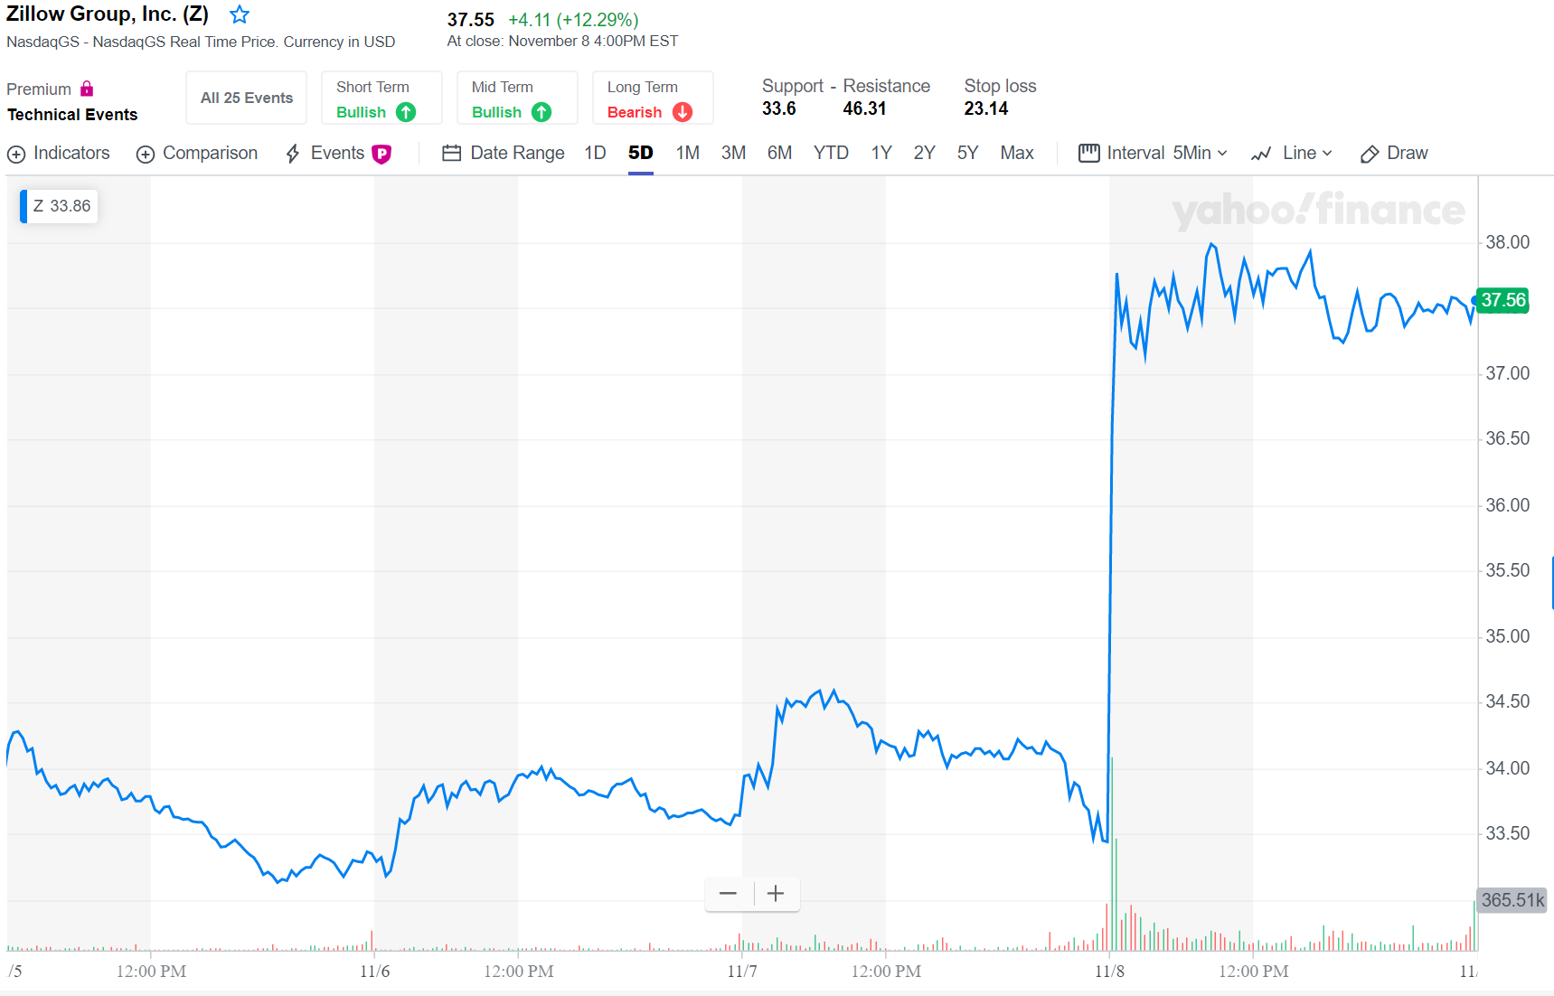
Competitive Markets
When constructing portfolios, millions of analysts and researchers search security markets for “best buys”
Investors rush in to buy securities on good news and sell on bad news: market efficiency
Announced revenue beat estimates and outlook is positive.
p. 11

Slide 21
6. Investors, Objectives, and Constraints

Slide 22
Investor Objectives & Questionnaire
Investors balance Return Requirements and Risk Tolerance based on their needs and preferences.
Click or tap Excel logos to open the spreadsheet
Excel Exercise:
Investor Questionnaire

Slide 23
To Summarize
We’ve discussed financial assets, their role in the economy, markets, market players, and the factors that go into investing choices.
But what can we learn from history (and markets today)?

Slide 24
7. Recessions and Financial Market Crises

Slide 25
The Financial Crisis of 2008: The Great Recession
Money to Buy a Home
Money to Lend
Investment Dollars
$
$
$
Mortgages
Banks
Fannie/Freddie
Investors
$
$
$
Principal and Interest
Principal and Interest
Principal and Interest
Collects Servicing Fee
Collects Guarantee Fee
p. 15

Slide 26
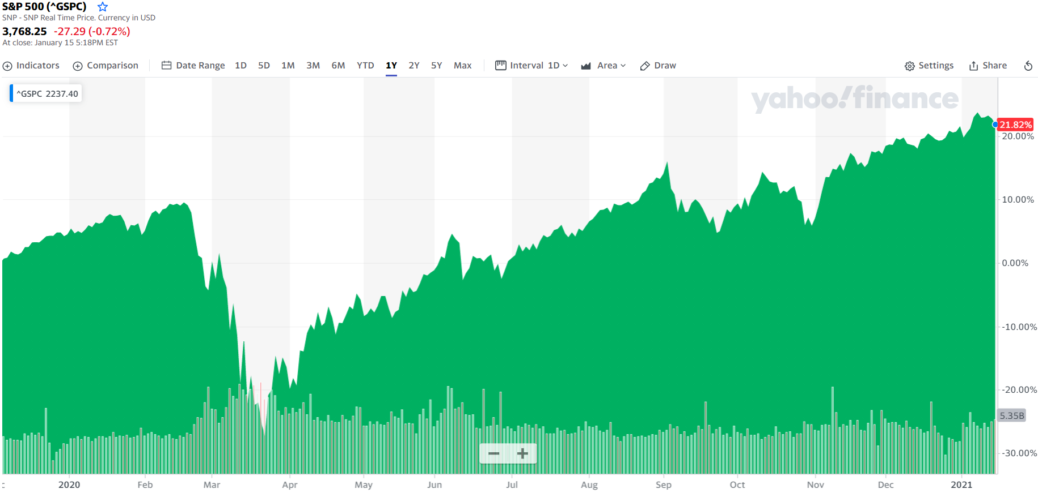
COVID-19, Financial Markets, and the Economy

Slide 27
COVID-19, Financial Markets, and the Economy
Why are stock markets near all-time highs in the middle of a recession?
The stock market is not the economy.
Measures of employment and GDP tell us about the present and the near past. The stock market reflects investors’ assessment of the present value of future cash flows owners of firms are entitled to.

Slide 28
8. Conclusions

Slide 29
To Conclude
Investments are current commitments of resources in expectation of future benefits
Financial assets perform a number of roles
Efficient allocation of resources requires transparent information
Markets are competitive, fueling efficiency
Investors have varying needs and constraints
Past financial crises provide important lessons

